Slide 1


SAP CLOUD APPLICATION PROGRAMMING AND XSA TRAINING IN BPT
Anubhav Oberoy
Day – 6

Slide 2

Agenda – Day 6
Introduction to Views in SAP CAP
Why we need Views.
Introduction to OData
Understanding the use of OData services
Implementing OData service
Introduction to OData V2 Proxy
Converting OData V4 to OData V2

Slide 3
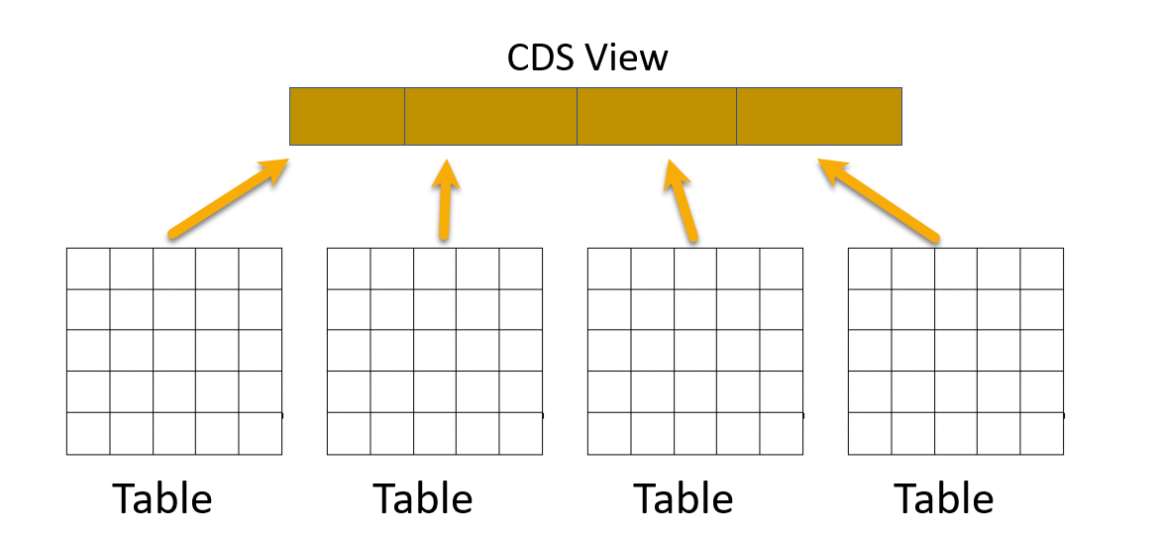
Introduction to Views in SAP CAP
Core Data Service (CDS) Views are virtual data models of SAP HANA which allows direct access to underlying tables of the HANA database.
SAP CDS Views aim to push logic from the application server to the client-side and database. This is defined by SAP as ‘Code -to-Data’ or ‘Code Pushdown’.
CDS Views is an important technology for modern application development on SAP systems and should not be overlooked. They provide enhancements in terms of data modelling and enable improved performance when combined with SAP HANA database.
CDS Views allow developers to create semantically rich data models which the application services expose to UI clients.
While the data in SAP is still physically stored in transparent tables, CDS Views are an abstraction layer on top of the tables for data modelling purposes. They understand the relationship between database tables and hide the complexity from the programmer.

Slide 4
Why we need views in a software
They display non-normalized data. The data is spread in multiple tables, and it is difficult for developers to every time write JOINs.
The application needs data which is presentable to user
View gives security because users cannot update data using view
They can aggregate data like find total sales per customer.
Expose columns of technical type to more semantic names
Syntax of defining Views
Use the as select from variant to use all possible features an underlying relational database would support using any valid CQL query including all query clauses.
Case Insensitive Naming of the View
Case Sensitive Naming of the View
define view ViewName as
select from table{
};
define view! [ViewName] as
select from table{
};

Slide 5
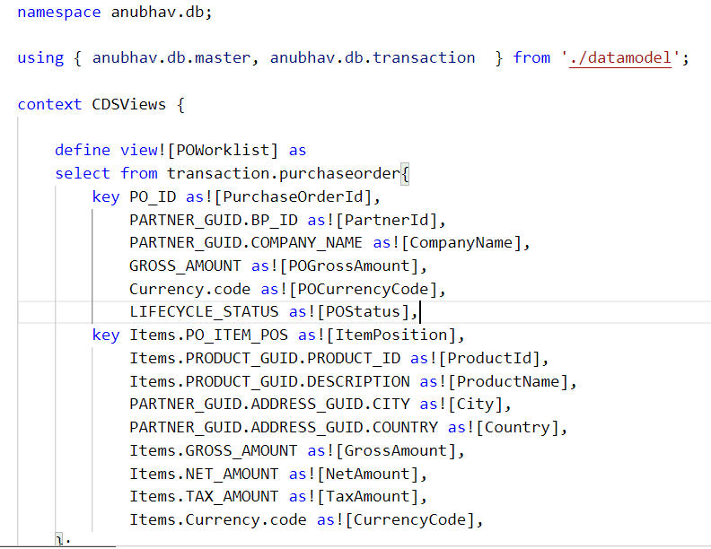
Hands-on: CDS Views
In this exercise we will create our first CDS View which will expose the non-normalized data for purchase order and purchase order items in combined form. We will expose this view using a new service named CDSService.
Exercise code/resource:
CDSViews.cds

Slide 6
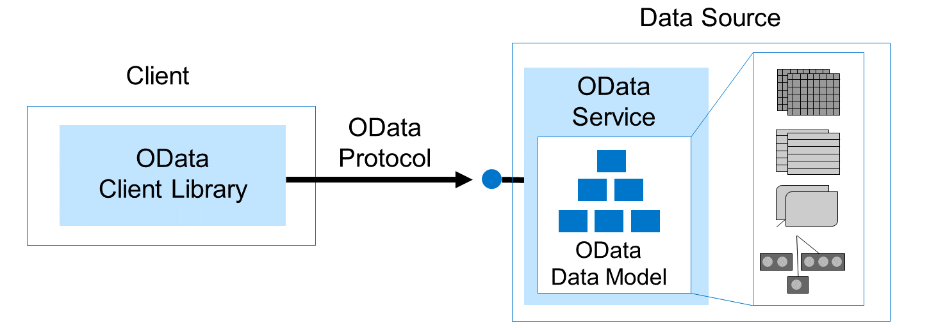
Introduction to OData
Open Data Protocol (OData) is an OASIS standard that defines the best practice for building and consuming RESTful APIs.
OData helps you to focus on your business logic, while building RESTful APIs, without having to worry about the approaches to define request and response headers, status codes, HTTP methods, URL conventions, media types, payload formats, query options, and so on. It is an open standard, defined by the OASIS consortium.
OData Basics
OData Data Model : - Organize/Describe data with Entity Data Model (EDM).
OData Protocol : - REST-based create, read, update and delete + OData-defined query language.
Client Libraries : - Pre-built libraries to request OData and display results.
OData Services : - Exposes an end point that allows access to data in the SAP HANA Database

Slide 7
OData Service
OData is a way of performing database-style create, read, update, and delete operations on resources by using HTTP verbs:
GET: Get the resource (a collection of entities, a single entity, a structural property, etc.).
POST: Create a new resource.
PUT: Update an existing resource by replacing it with a complete instance.
PATCH: Update an existing resource by replacing part of its properties with a partial instance.
DELETE: Remove the resource.
An OData service is a logical data model; it describes entities (resources) using associations and operations. The most important point is that the OData service forms a kind of contract between the UI and the backend system side, helping to bring together developers on both sides.
There are two types of document associated with each OData service:
the service document - The service document lists entity sets, functions, and singletons that can be retrieved. Clients can use the service document to navigate the model in a hypermedia-driven fashion.
the service metadata document - The metadata document describes the types, sets, functions and actions understood by the OData service. Clients can use the metadata document to understand how to query and interact with entities in the service.
URL to access the service document:- http://<host>:<port>/<service>/
URL to access the service metadata document: - http://<host>:<port>/<service>/$metadata

Slide 8
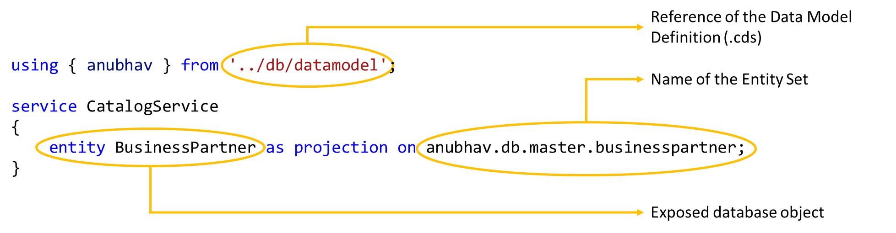
Exposing the OData Entity Set
At design time, within the srv folder, you create an .cds file where you indicate the exposed database object, for example, table, view, calculation view, and so on, and the name of the Entity Set in the service.
On build, the application provides an OData service, exposing the object content under the given entity set name.
Syntax to Expose the OData Entity Set

Slide 9
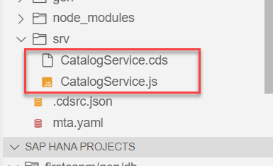
Exercise
In this exercise we will expose the data form the database in the form of OData by creating a OData service.
Steps to do the exercise.
Initially we have created a CatalogService.cds and CatalogService.js file in the srv folder to check labels in the metadata.
The CatalogService.cds file is known as the service definition file.
Put the code in that file form the below link.
Exercise Code/Resource:
CatalogService.cds
CatalogService.js

Slide 10
OData V2 Service
SAP CAP framework by default provides the OData V4 in the OData service.
But in most of the application developed in the Industry is based on the V2 version of the OData service.
OData V4 is only supported by the Fiori - List Report Application (LRP).
So, to over come this issue sap provides a module which converts the OData V4 generated by the CAP framework to the OData V2.
Npm module provided by SAP: - @sap/cds-odata-v2-adapter-proxy
This module can be install by using the command
npm install @sap/cds-odata-v2-adapter-proxy
Now to use this module, we have to make a file named server.js in the /srv folder.
In this folder we have to write a bootstrap code to use the OData V2.
SAP CAP Framework
OData V2 Adapter proxy
OData V4
OData V2

Slide 11
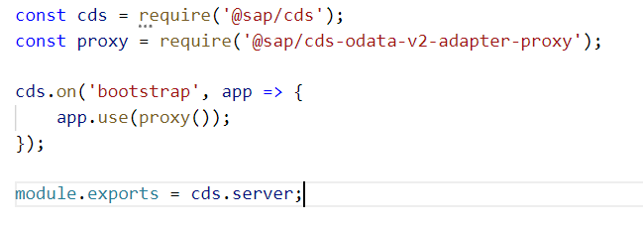
Hands-on: OData V2 Proxy
Create a new file server.js and write the bootstrapping code for the V2 adapter proxy.
Exercise Code/resource:
server.js

Slide 12
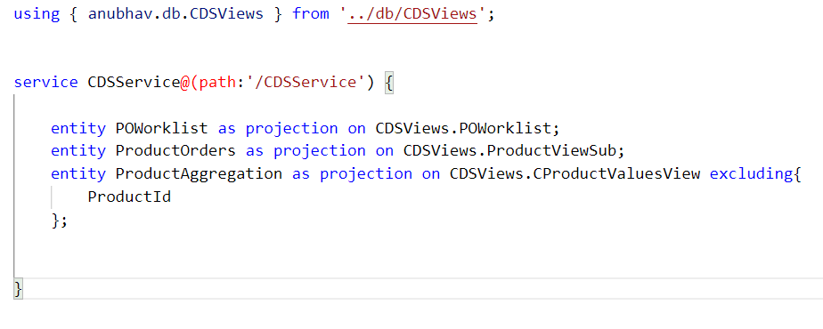
Hands-on: Exposing CDS Views
In this exercise we will expose the CDS views which we have created in the previous exercise. For that we will create a new file named CDSService.cds in the srv folder and paste the below code in it.
Exercise code/resource:
CDSService.cds

Slide 13

End of Day 6

Slide 14

Questions

Slide 15

Anubhav Oberoy

Slide 16


We’re committed to empower you to be
Most Desirable Resource
through powerful training solutions.
We build the workforce of the future.
250+
Corporate Clients
30,000+
Learners Trained
25000+
Learners Placed
FREE WEBINARS
Sign up for free webinars with industry experts every fortnight!
Enroll Now!
Contact us today!
https://anubhavtrainings.com/

Slide 17




More from AnubhavTrainings.com

Slide 18
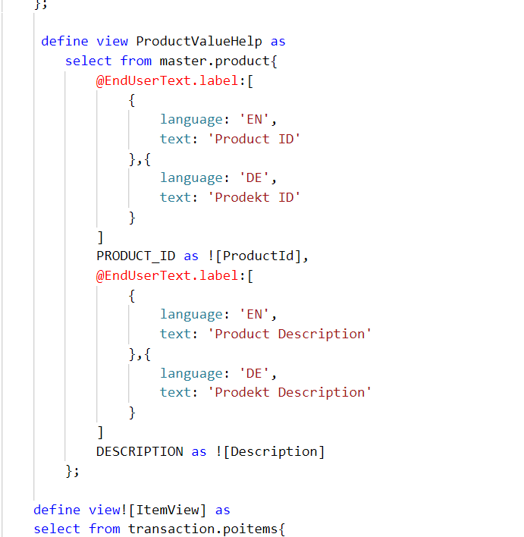
Hand-on: Advance CDS View
As we have seen the concept of views in SAP CAP. Now we will create some more views to understand the some advance concepts like creating Value Helps and View on View concept and expose them.
Exercise code/resources:
CDSViews.cds

Slide 19
Title
Content

